Slide 1
Healthcare Chatbot
Kunal Inglunkar, Xue Ming Wang
STAT 6289 Deep Learning Final Project
Option 3 - Self-Defined Project
Github Link: https://github.com/Kunal-1669/deep_learning_Final_Project.git

Slide 2

Introduction
Within healthcare, chatbots act as virtual assistants, aiming to streamline communication between individuals and healthcare providers.
Our project focuses on creating a dynamic and intelligent chatbot platform to elevate user interactions to new heights.

Slide 3

Goal of Project
The intention of this project is to develop an intelligent healthcare chatbot that utilizes deep learning techniques, such as word embedding and LSTM model, to enhance patient care by providing accurate, personalized, and immediate medical assistance.

Slide 4
Dataset
ChatDoctor-HealthCareMagic-100k From Lavita on Hugging face website.
Total of 112165 rows × 3 columns
Columns:
Instruction
Input
Output
Source:https://huggingface.co/datasets/lavita/ChatDoctor-HealthCareMagic-100k

Slide 5
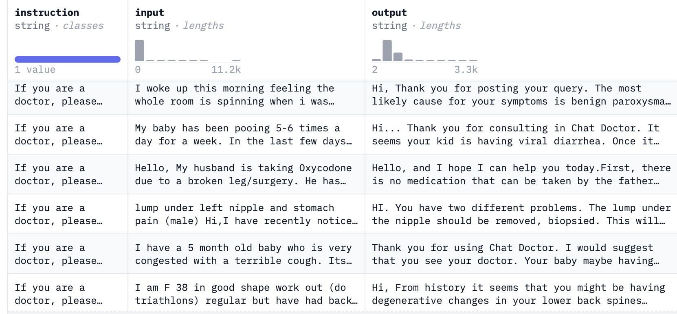

Slide 6
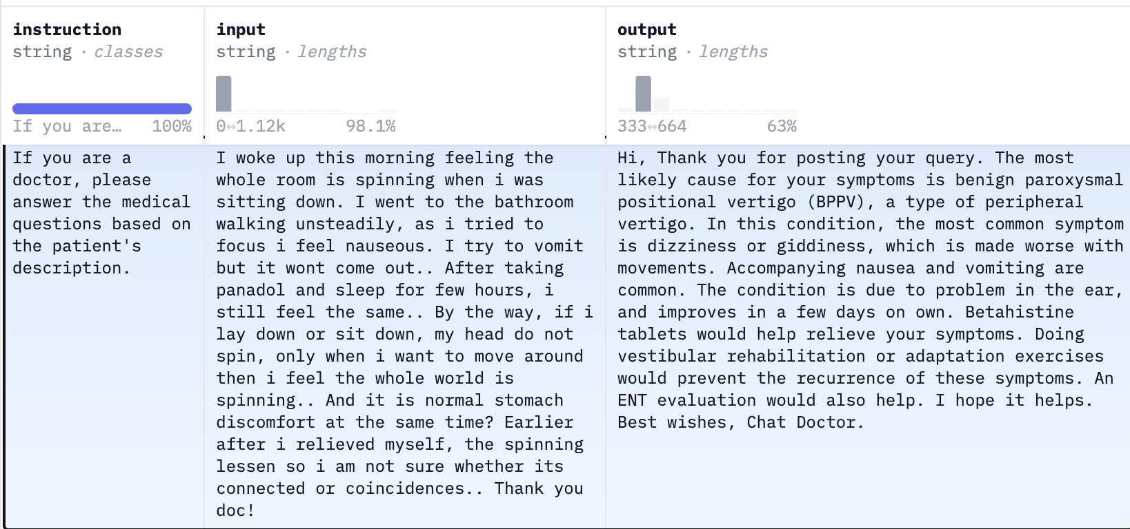

Slide 7
Preprocessing
Drops the 'instruction' column.
Removing unnecessary characters, lowercase conversion, punctuation removal, and lemmatization.
Uses NLTK for text preprocessing:
Tokenizes the text.
Removes stop words from the tokenized text.
Performs stemming on the tokenized text using the Porter Stemmer.
Notes:
reducing them to their base or canonical forms based on their context within the sentence.
Tokenization breaks text into smaller units.
Stop words, like "and" or "the," are taken out from these units.
The Porter Stemmer shortens words to their root forms for consistency.

Slide 8
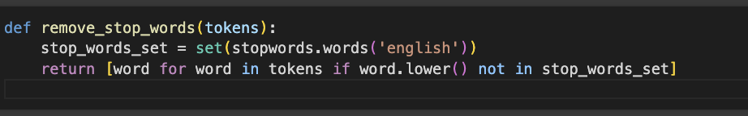
Challenge Faced with Preprocessing
Large dataset prolonged word embedding.
We have optimised operations by exporting the data to a CSV file.
Notes:
Revised version: The dataset was really big, which made embedding words take a long time. At first, the CSV couldn't be read properly, so we had to redo the prep and embedding steps multiple times. Later on, we discovered that using VS Code enabled us to efficiently manage and save the process with the dataset. Finally, we adapted our prep and embedding methods to successfully save it in a CSV file within VS Code.
Old version: The dataset is too large, word embedding process took too long and csv was not able to read at first, so we had to run the preprocessing and word embedding process again and again. We discovered that using vs code could keep the dataset. Eventually, we find a way to change preprocessing and word embedding process to able to save it to csv

Slide 9
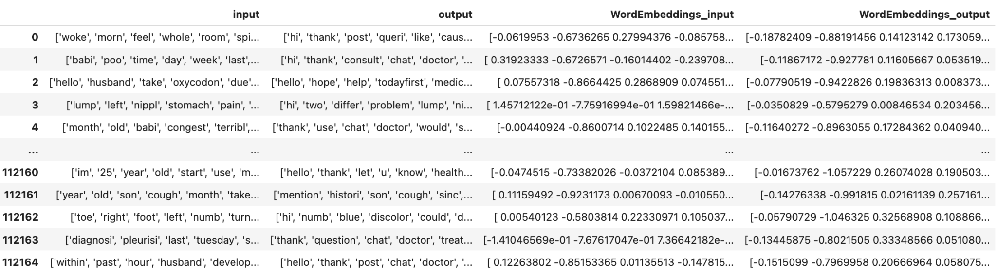
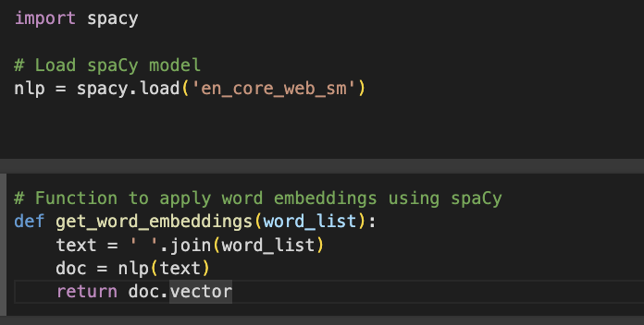
Word Embeddings
Utilizes spaCy to load an English language model.
Converts the tokenized text into word embeddings using spaCy's word vectors.

Slide 10
Padding
Sample the dataset to 7000 rows.
To maintain uniformity in input and output dimensions, we implement padding techniques. This not only facilitates seamless data processing but also enhances the stability and performance of our model.
Padding Sequences: Pads the input and output sequences to a uniform length (max_len), ensuring uniformity for model input.
Notes:
Tokenization and Padding:
Tokenizer Initialization: Initializes a tokenizer and fits it on the extracted sequences.
Texts to Sequences: Converts text sequences to sequences of integers using the fitted tokenizer.
Padding Sequences: Pads the input and output sequences to a uniform length (max_len), ensuring uniformity for model input.

Slide 11

Challenge Faced with Model Building
Massive dataset caused kernel restart with each model.
Started with a 1000-row subset to mitigate kernel issues.
Incrementally increase subset size for stability.
Notes:
Because of the massive dataset, every model we built resulted in a kernel restart. To counter this, we opted to begin by subsetting the dataset to 1000 rows and gradually increase it as much as possible.

Slide 12
Splitting dataset
Splits the data into training and validation sets.
80% training & 20% validation.
X_train, X_val, y_train, y_val
Code: X_train, X_val, y_train, y_val = train_test_split( padded_input, padded_output, test_size=0.2, random_state=42)

Slide 13
Model Building
Embedding layer (Converts input sequences into dense vectors)
LSTM layer
TimeDistributed Dense layers (Apply a dense layer to each time step of the sequence independently).
Model Compilation: Compiles the model with the Adam optimizer and sparse categorical cross-entropy loss.

Slide 14
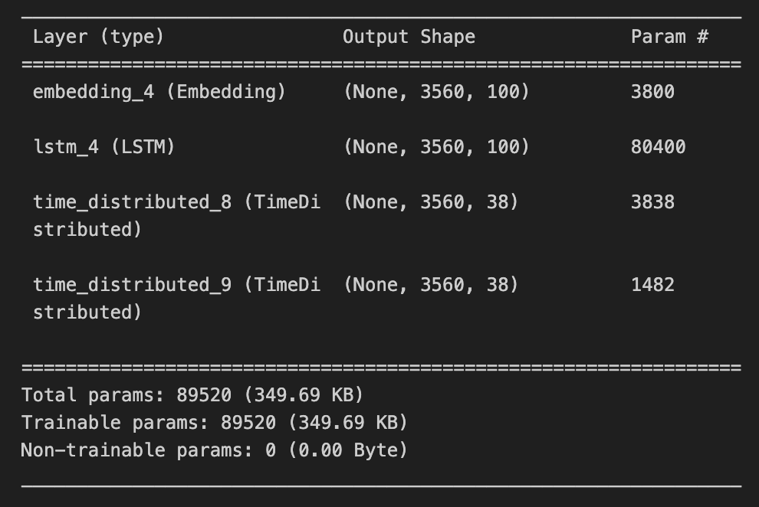

Slide 15
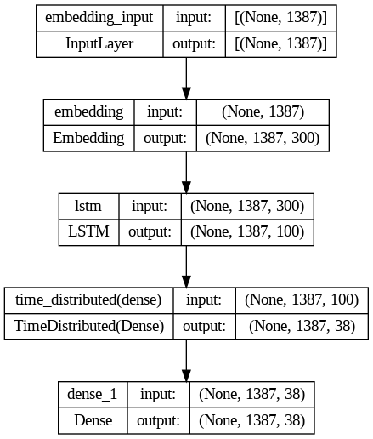

Slide 16
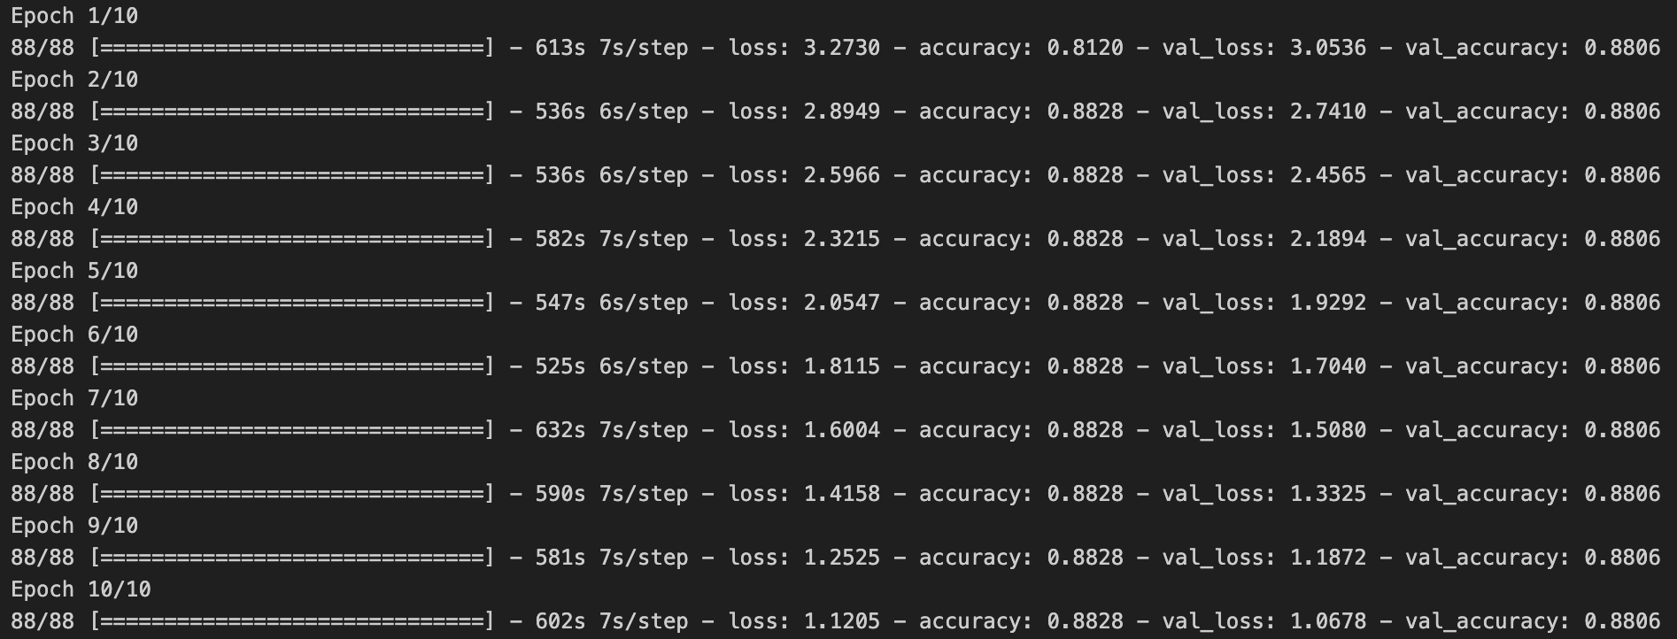
Model Training
10 epochs with a batch size of 64.

Slide 17


Evaluating the Model

Slide 18
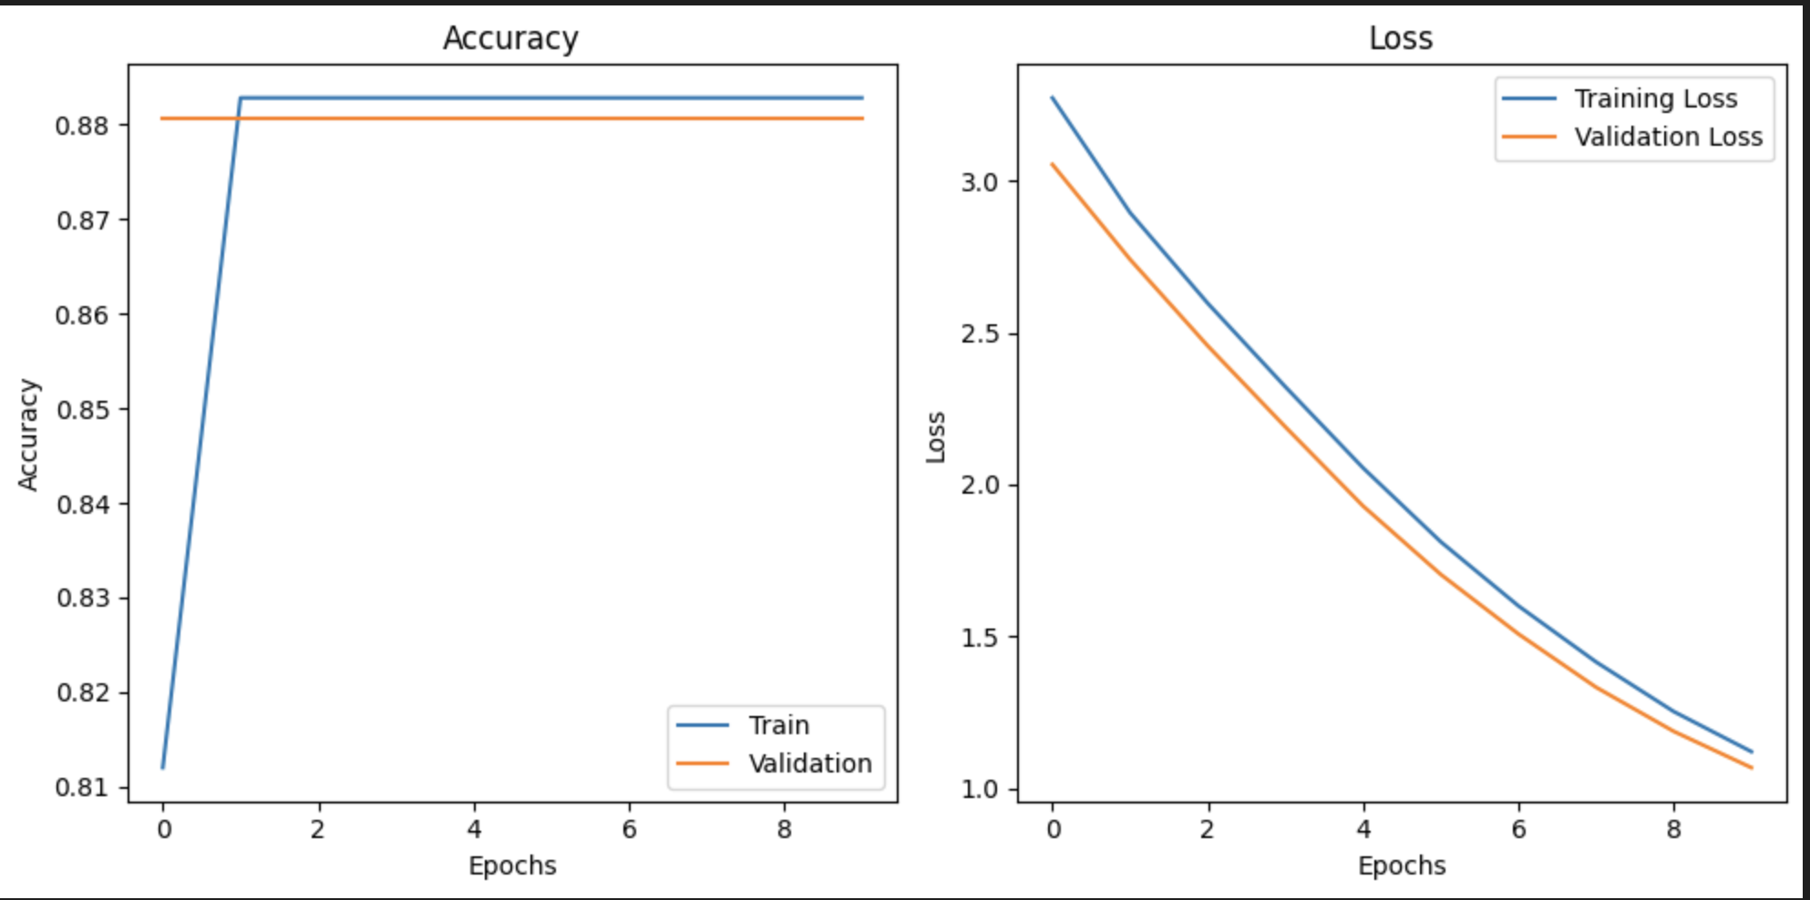
Accuracy and Loss Plot

Slide 19
Making Predictions
Preparing Input:
Use tokenizer.texts_to_sequences() to converts input text to a sequence of integers
Predicting Output:
pad_sequences to pads input sequence for model compatibility.
model.predict() to predicts the output sequence based on the input
Converting Output to Text:
tokenizer.sequences_to_texts(predicted_output_sequence.argmax(axis=-1))[0] => Converts predicted output sequence back to text.

Slide 20
Takeaways

Slide 21
Conclusion
This chatbot streamlines communication and enhances patient care.
The models enables accurate and personalized medical assistance.
Leveraging model building, compilation, and prediction steps, the chatbot efficiently transforms input text into precise, helpful medical guidance.

